Slide 1
District 43
Speech Contest Training
Mastering the Basics:
Toastmasters Contest Overview & Preparation

Slide 2
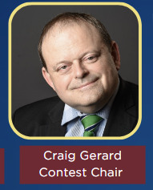
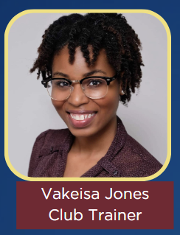
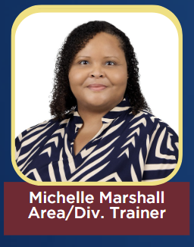
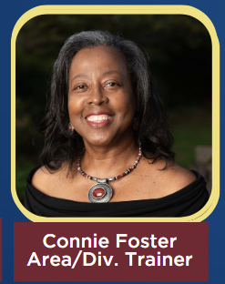
Welcome

Slide 3
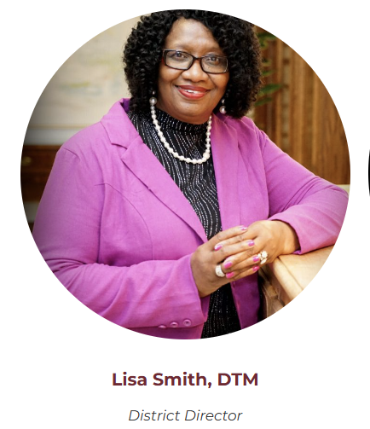
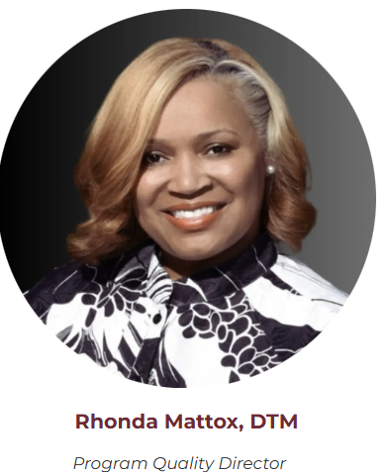
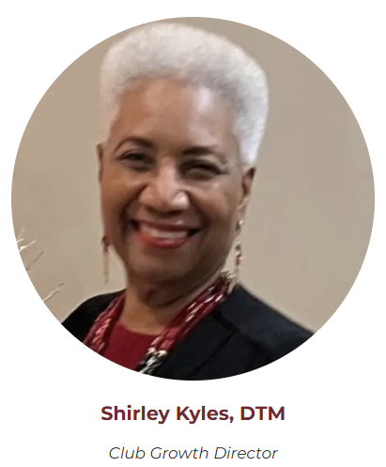
Recognition

Slide 4
Purpose and Transparency Statement
We aim to fully support you in preparing for a successful contest experience! For any contest-related questions, your top resources are the Toastmasters International Speech Contest Rulebook and the Speech Contest Page. Additionally, Craig Gerard has kindly offered his expertise to answer urgent questions. Please respect his time by consulting all available resources before contacting him.

Slide 5
Agenda
Part 1: General District 43 Speech Contest Information
Part 2: Overview of the Speech Contest Rulebook
Part 3: Overview of Speech Contest Preparation
Final Thoughts
Q & A

Slide 6
Part 1:
General District 43 Speech Contest Information

Slide 7
PART 1 : Objectives
Understand the Contest Speech Benefits
Review District 43 Contest Information

Slide 8
Contest Speech Benefits
Opportunities to Compete
Opportunities to learn new skills
Experience organizing an event
Opportunities to network
Opportunities to have FUN!!
3

Slide 9
District 43 Contest Information
District Leaders Speech Contest Expectations
Contests must be held at the Area, Division, and District levels. The Area speech contest winner then proceeds to the Division contest. The Division winner then proceeds to the District contest.
Districts must hold the International Speech Contest every year.
Districts are allowed to hold up to three additional contests per year.
5

Slide 10
District 43 Contest Information - VPEs Expectations
VPEs Speech Contest Expectations
NOTE: While club contests are encouraged, they are not mandatory for clubs.
Contestants may only be nominated at club level.
Vice Presidents of Education (VPEs) play a vital role in the speech contest process by organizing and supporting members in their preparation.
They ensure contestants understand contest rules, coordinate practice opportunities, and foster a supportive environment that encourages participation and growth.
VPEs are key in motivating and guiding members through the contest journey, helping them gain confidence and polish their skills for success.
5

Slide 11
District 43 Contest Information
Contest Chair by Level
Club VP Education
Area Area Director
Division Division Director
District Program Quality Director or Appointed
Note: Area and Division Directors can appoint a Contest Chair if they meet the eligibility requirements within the Speech Contest Rulebook. Ultimately, it is the responsibility of the District Leader to ensure the successful execution of the contests.
3

Slide 12
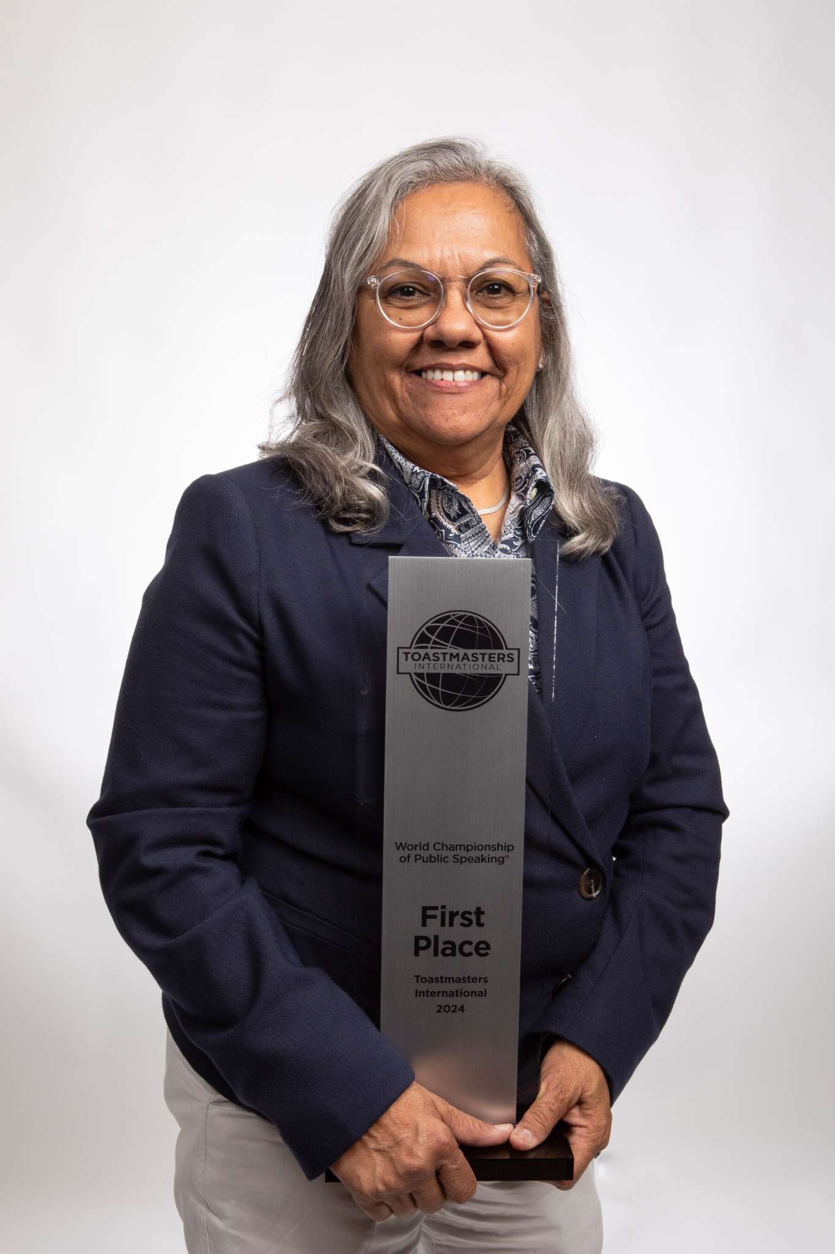
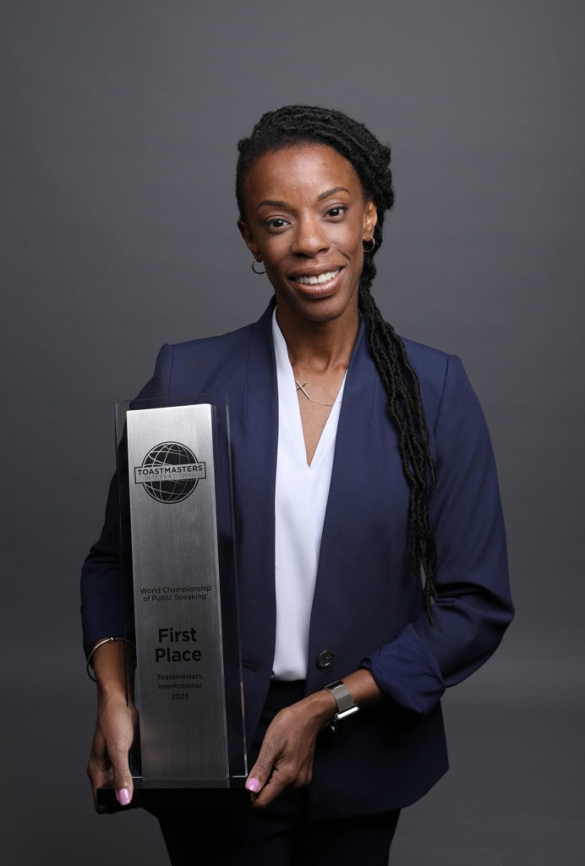
District 43 Contest Information
2025 Speech Contests
International Speech
Table Topics
2024 Luisa Montalvo
(Texas)
2023
Jocelyn Tyson (South Jersey)
2022
Cyril Junior Dim (Poland)

Slide 13
District 43 Contest Information
District 43: Speech Contest Season 2024-2025
Club Contests
Conducted by January 21, 2025 (In Person on Online)
Area Contests
Conducted by February 21, 2025 (In Person)
Division Contests
Conducted by March 21, 2025 (In Person)
District Contests
April 11th -12th Memphis, Tennessee (Save the Date) (In Person)
12

Slide 14
PART 1 Completed!
Poll Question!

Slide 15
Part 1
Poll Question
What do you see as the biggest benefit for clubs participating in contests?
Building stronger speaking skills across members
Increasing member engagement and enthusiasm
Fostering a sense of community and achievement
Promoting growth within the Toastmasters pathway

Slide 16
Part 2:
General Overview of the Speech Contest Rulebook

Slide 17
PART 2: Objectives
Identify Types of Speech Contest and Speech Contest Progression
Identify Eligibility Criteria
Identify Functionary Roles for the Speech Contest

Slide 18
Speech Contest Types and Progression
Types of Speech Contest
International Speech
Evaluation
Humorous
Table Topics
Tall Tales
Video (for members of undistricted* clubs and for provisional districts)
*undistricted clubs = provisional clubs, online
clubs
2024 Toastmasters World Champion Luisa Montalvo
3

Slide 19
Speech Contest Types and Progression
Speech Contest Progression
Club Contests
1
Area Contests
2
Division Contests
3
District Contests
4
Regional
Quarter
Finals
5
Semi
Finals
6
International Contest
7

Slide 20
Identify Eligibility Criteria
Standard Eligibility Requirements
Paid Member in the area, division, and district you are competing
Club must be in good standing
New, dual, or reinstated member must have dues and membership application on file with World Headquarters
Maintain eligibility at all levels of any contest
International Speech Contest
Standard Eligibility Requirements
Earned certifications of completion in Levels 1 and 2 of any Pathways path OR, earned the Distinguished Toastmaster designation.
2

Slide 21
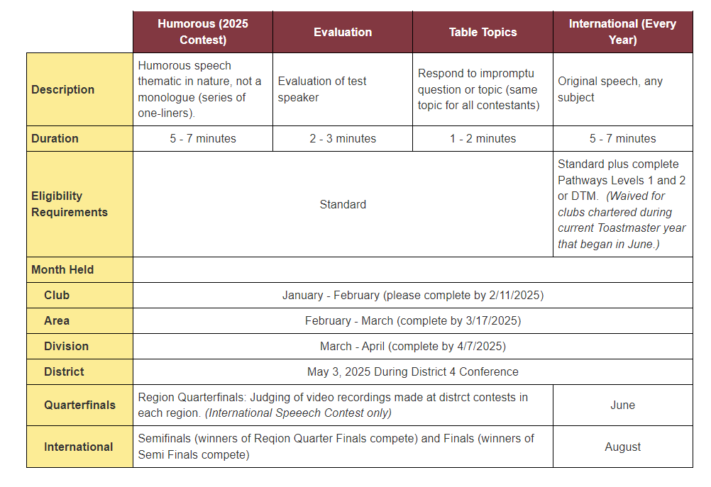
Identify Eligibility Criteria
Picture from District 4
5

Slide 22
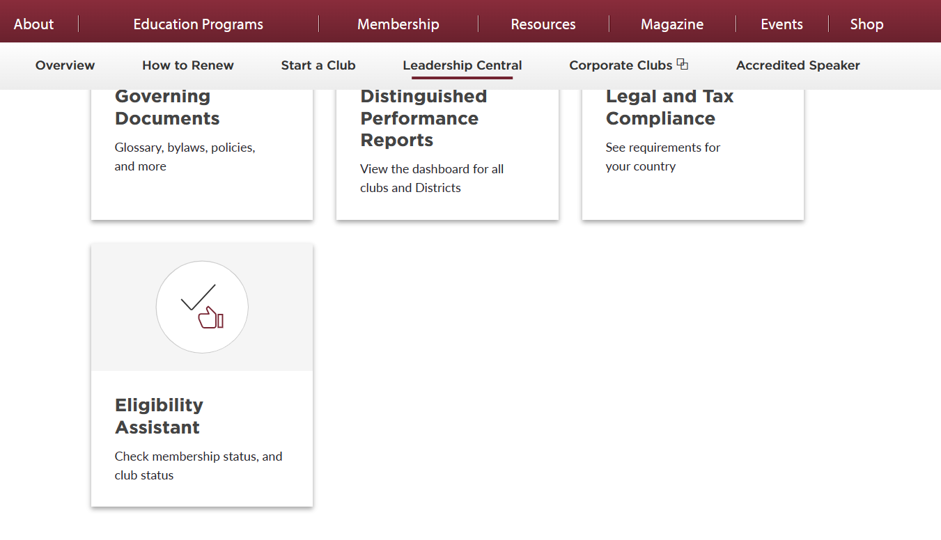
Checking Eligibility
Identify Eligibility Criteria

Slide 23
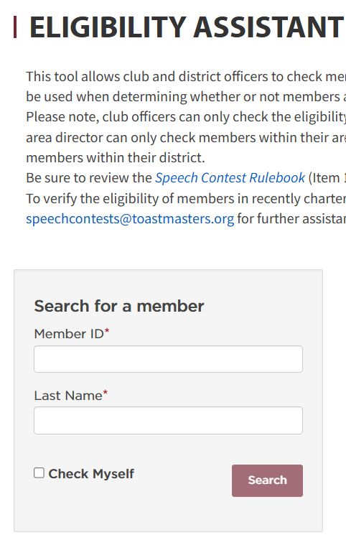
Checking Eligibility
Identify Eligibility Criteria
Contest Eligibility Forms
Speaker’s Certification of Eligibility and Originality
Judge's Certification of Eligibility and Code of Ethics

Slide 24
Checking Eligibility
Identify Eligibility Criteria
Note: Check roster for education requirement. Contest Chairs and Chief Judges will need to work with Area and Division Directors to assist with eligibility beyond club levels.

Slide 25
Speech Contest Functionary Roles
3

Slide 26
Speech Contest Functionary Roles
Staffing a speech contest
Contest Officials | Club | Area | Division | District
Contest Chair | 1 | 1 | 1 | 1
Contest Toastmaster | optional** | optional** | optional** | optional**
Chief Judge | 1 | 1 | 1 | 1
Judges | 5 | *Equal number of voting judges from each club in the area or 5 minimum. | *Equal number of voting judges from each area in the division or min 7.No Judge shall be a member of any club in which a contestant is a member. | *Equal number of voting judges from each Division in the District or min 7.No Judge shall be a member of any club in which a contestant is a member.
Tie Breaking Judge | 1 | 1 | 1 | 1
Ballot Counters | 2 | 2 | 2 | 3
Timer | 2 | 2 | 2 | 2
Test Speaker for Evaluation Contest | 1 | 1 | 1 | 1
Sgt at Arms | 1 | 1 | 1 | 1
 | *unless impractical
 | **Rulebook Page 11

Slide 27
Speech Contest Functionary Roles
Contest Chair
Plan the Contest
Select Date / Time / Location
Create the Agenda
Download Certificates
Order Trophies
Verify Speaker Eligibility
Appoints Chief Judge
Appoints Sergeant at Arms
Serve as Contest Toastmaster if one is not appointed
Area/Division Director can appoint a Contest Chair.

Slide 28
Speech Contest Functionary Roles
Chief Judge
Appoints
Voting Judges (Check Voting Judges Eligibility - Speech Contest Rulebook )
Ballot Counters
Timers
Secret Tie Breaking Judge
Conduct Judges and Functionary Briefing
Provides Counters’ Tally Sheet and Timer’s Sheet
Oversee Ballot Counting

Slide 29
Speech Contest Functionary Roles
Contest Toastmaster (Optional)
Runs the contest
Brief the Contestants
Works with Contest Chair to setup and run speech contest
Reads the script and MCs the Contest

Slide 30
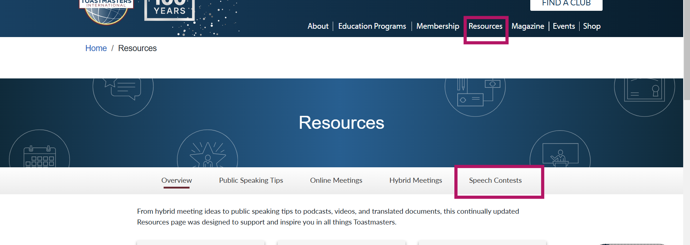
Speech Contest Functionary Roles
Staffing a speech contest

Slide 31
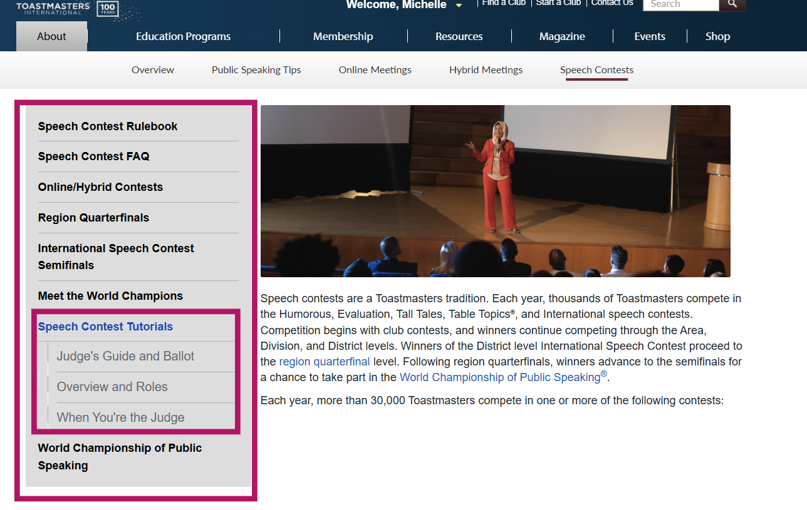
Speech Contest Functionary Roles
Video Tutorials

Slide 32
PART 2 Completed!
Quiz Time!

Slide 33
Part 2
Quiz Question
Which role below is considered a “functionary” role essential for a speech contest?
Contestant
Timer
Club Mentor
Guest Speaker

Slide 34
Part 2
Quiz Question
The Voting Judge is responsible for debriefing the contest functionaires before the contest.
True
False

Slide 35
Part 3:
Overview of Speech Contest Preparation

Slide 36
PART 3
Identify Essential Contest Forms and Resources
Review Timeline and Checklist for Contest Preparation

Slide 37
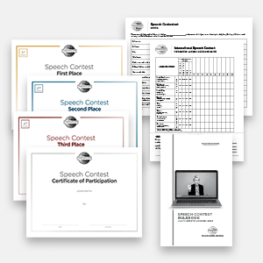
Identify Essential Contest Forms and Resources
Resources
Toastmasters Speech Contest Page
Speech Contest Rulebook
Club (Option for Clubs Only)
Online and Hybrid Speech Contest Best Practices
Forms
Toastmasters International -International Speech Contest Kit
Table Topics Speech Contest Kit
2

Slide 38
Optional Resources
Curated Speech Contest Information from Various Districts (Extra References, If Needed)
Toastmaster District | Link | Information Highlight
District 4 | District 4 Speech Contest Resource | District 4 offers a section with tutorials and a district contest script that can serve as a source of inspiration and valuable insights.
District 31 | District 31 Speech Contest Resource | District 31 provides a section with a Sample Contest Agenda to assist with organization, including options for joint contests.
District 47 | District 47: Zoom Contest Coordinator Training | District 47 offers a YouTube tutorial on contest procedures specifically designed for Zoom Masters.
District 14 | District 14 Speech Contest Training | District 14 offers a collection of YouTube videos for contest training, with content produced in 2022 and later.
District 1 | District 1: Toastmasters-Speech-Contest-Chair-Planning-Action-Doc.pdf | District 1 provides a speech contest checklist to assist with planning. Keep in mind that you can tailor the checklist to fit your specific needs—you don’t need to use every item.
2

Slide 39
Review Timeline and Checklist for Contest
Plan – start early
Utilize the Checklist in the Speech Contest Rulebook
Communicate with your Team
Prepare for the unexpected
Timeline
Pre-Contest (6-8 weeks out): Secure venue, recruit judges, promote event
2-4 Weeks Prior: Finalize contestant list, prepare ballots, confirm roles
1 Week Prior: Rehearse setup, review checklist with team, confirm logistics
2

Slide 40
Review Timeline and Checklist for Contest
Overview: Speech Contest Flow
Briefings (Contest Chair and Chief Judge)
Speech Contest
Judging and Contestants Interviews (Simultaneously)
Announcement of Winners
Email Notifications and Certificates
Details in Speech Contest Rulebook
2

Slide 41
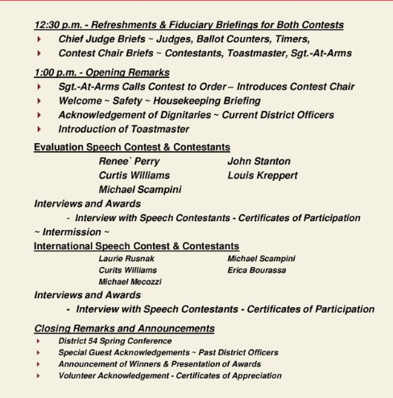
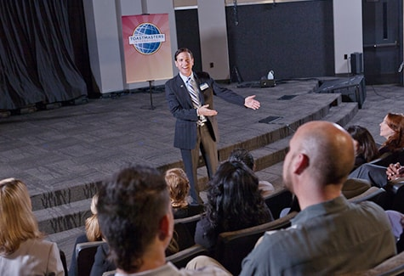
Review Timeline and Checklist for Contest
Example Agenda:
Areas Speech Contest (In-Person)
2

Slide 42
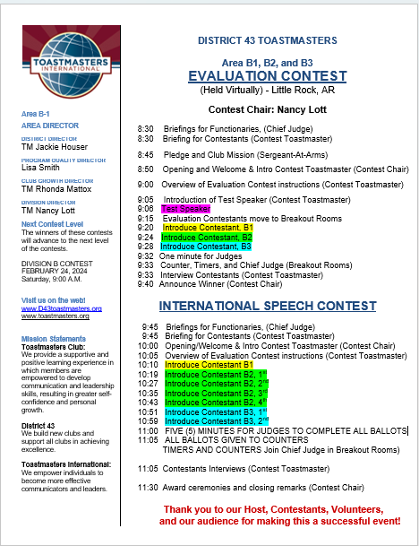
Review Timeline and Checklist for Contest
Example Agenda:
Virtual Joint Areas (Division B) Speech Contest Agenda.
Modify for In-Person
2

Slide 43
PART 3 Completed!
Quiz Time!

Slide 44
Part 3
Quiz Question
What is one key requirement for an Area or Division Director when organizing a contest?
Selecting all contestants
Communicating contest expectations and organizing resources
Personally judging the contest
Hosting a post-contest reception

Slide 45
Let’s Wrap it Up…Final Thoughts!

Slide 46
In Summary…Final Thoughts
The benefits of speech contest extended to the participants, audience, and those conducting the contests.
Because club officers depend on Area and Division Directors to answer questions about speech contests, it is important for Area and Division Directors to have thorough understanding of how speech contest work and where to find answers when questions arise.
14

Slide 47
Final Thoughts
During the planning phase of speech contest, it is important to choose fair and impartial judges and train contest officials.
Issues related to judging arise at lower levels of competition, specially at the Area level, because of lack of training.
Area and Division Directors are not expected to know all the speech contest rules. They are expected to locate the tools they need to answers questions and solve challenges.
14

Slide 48
Q & A
Craig Gerard, Contest Chair
Email: craiggerard_2000@yahoo.com

